Slide 1
Chloe Chen

Slide 2
2025 EOY Bonus

Slide 3
Bonus
Bonus Depends on company results & your results
2025 sales were down vs. 2024 and vs. our target.
However, we did a better job of managing our costs and improved our profitability.
Flyers can receive up to 100% of their bonus.
Your 2025 Bonus Potential
RMB 1,020 2 Months
Your 2025 Actual Bonus
RMB 2,000 2 Months 5% of Potential

Slide 4
2026

Slide 5
2026 Salary
Current Salary
RMB 3,086 Per month
2026 Salary
RMB 4,086 Per month
Merit Increase %
6 %
2026 Bonus Potential
RMB 5,023 1 Months

Slide 6
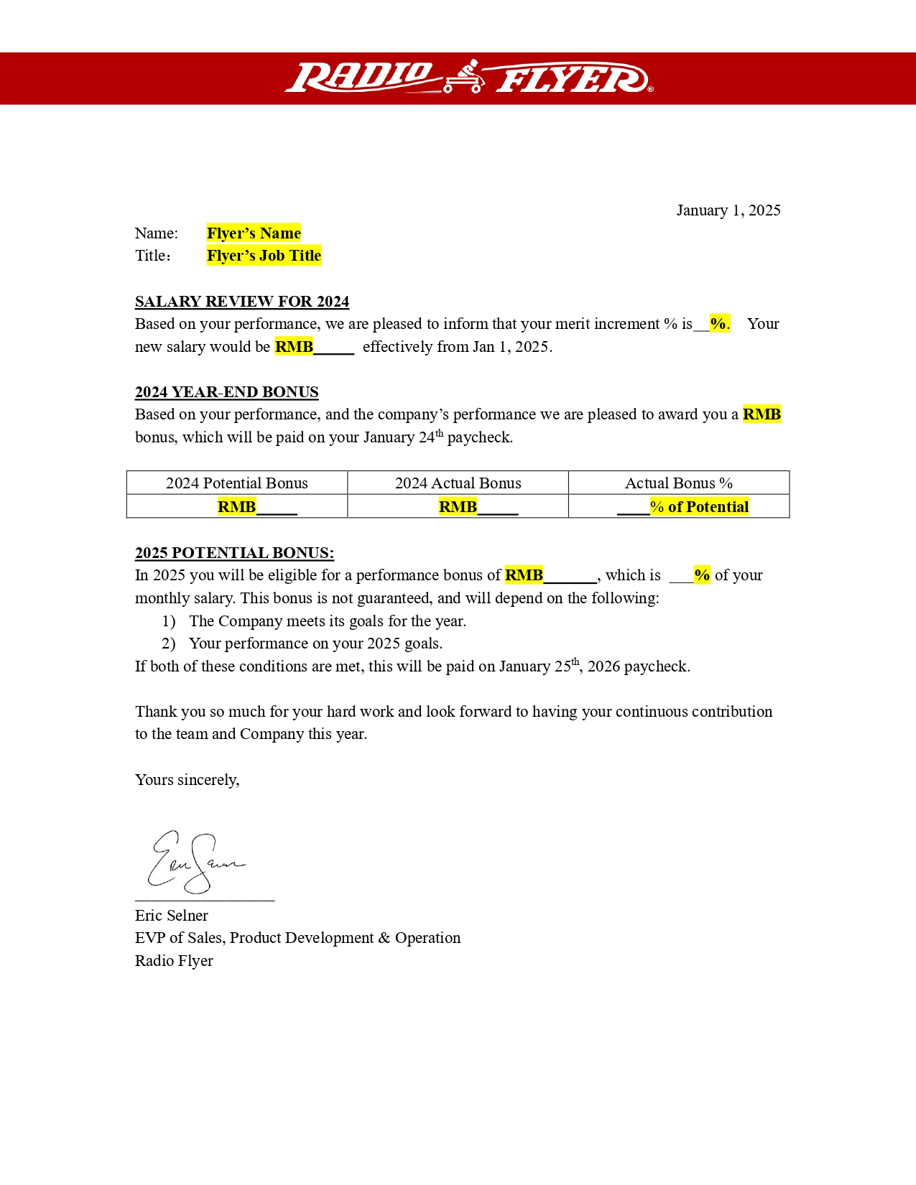

Slide 8
Ricky Wong

Slide 9
2025 EOY Bonus

Slide 10
Bonus
Bonus Depends on company results & your results
2025 sales were down vs. 2024 and vs. our target.
However, we did a better job of managing our costs and improved our profitability.
Flyers can receive up to 100% of their bonus.
Your 2025 Bonus Potential
RMB 1,082 7 Months
Your 2025 Actual Bonus
RMB 2,040 6 Months 9% of Potential

Slide 11
2026

Slide 12
2026 Salary
Current Salary
RMB 3,039 Per month
2026 Salary
RMB 4,074 Per month
Merit Increase %
8 %
2026 Bonus Potential
RMB 5,051 0 Months

Slide 15
Jasmine Mei

Slide 16
2025 EOY Bonus

Slide 17
Bonus
Bonus Depends on company results & your results
2025 sales were down vs. 2024 and vs. our target.
However, we did a better job of managing our costs and improved our profitability.
Flyers can receive up to 100% of their bonus.
Your 2025 Bonus Potential
RMB 1,047 5 Months
Your 2025 Actual Bonus
RMB 2,009 8 Months 2% of Potential

Slide 18
2026

Slide 19
2026 Salary
Current Salary
RMB 3,087 Per month
2026 Salary
RMB 4,053 Per month
Merit Increase %
7 %
2026 Bonus Potential
RMB 5,089 0 Months

Slide 22
Queenei Ren

Slide 23
2025 EOY Bonus

Slide 24
Bonus
Bonus Depends on company results & your results
2025 sales were down vs. 2024 and vs. our target.
However, we did a better job of managing our costs and improved our profitability.
Flyers can receive up to 100% of their bonus.
Your 2025 Bonus Potential
RMB 1,050 6 Months
Your 2025 Actual Bonus
RMB 2,099 7 Months 3% of Potential

Slide 25
2026

Slide 26
2026 Salary
Current Salary
RMB 3,045 Per month
2026 Salary
RMB 4,007 Per month
Merit Increase %
5 %
2026 Bonus Potential
RMB 5,061 8 Months

Slide 27
Image: Flyer’s salary letter

Slide 29
Ziwei Ye

Slide 30
2025 EOY Bonus

Slide 31
Bonus
Bonus Depends on company results & your results
2025 sales were down vs. 2024 and vs. our target.
However, we did a better job of managing our costs and improved our profitability.
Flyers can receive up to 100% of their bonus.
Your 2025 Bonus Potential
RMB 1,076 9 Months
Your 2025 Actual Bonus
RMB 2,047 9 Months 6% of Potential

Slide 32
2026

Slide 33
2026 Salary
Current Salary
RMB 3,002 Per month
2026 Salary
RMB 4,036 Per month
Merit Increase %
7 %
2026 Bonus Potential
RMB 5,031 0 Months

Slide 34
Image: Flyer’s salary letter

Slide 36
Catherine Tang

Slide 37
2025 EOY Bonus

Slide 38
Bonus
Bonus Depends on company results & your results
2025 sales were down vs. 2024 and vs. our target.
However, we did a better job of managing our costs and improved our profitability.
Flyers can receive up to 100% of their bonus.
Your 2025 Bonus Potential
RMB 1,017 6 Months
Your 2025 Actual Bonus
RMB 2,043 0 Months 4% of Potential

Slide 39
2026

Slide 40
2026 Salary
Current Salary
RMB 3,053 Per month
2026 Salary
RMB 4,084 Per month
Merit Increase %
4 %
2026 Bonus Potential
RMB 5,075 4 Months

Slide 41
Image: Flyer’s salary letter

Slide 43
Micky Wang

Slide 44
2025 EOY Bonus

Slide 45
Bonus
Bonus Depends on company results & your results
2025 sales were down vs. 2024 and vs. our target.
However, we did a better job of managing our costs and improved our profitability.
Flyers can receive up to 100% of their bonus.
Your 2025 Bonus Potential
RMB 1,077 4 Months
Your 2025 Actual Bonus
RMB 2,092 0 Months 8% of Potential

Slide 46
2026

Slide 47
2026 Salary
Current Salary
RMB 3,050 Per month
2026 Salary
RMB 4,093 Per month
Merit Increase %
4 %
2026 Bonus Potential
RMB 5,065 0 Months

Slide 48
Image: Flyer’s salary letter

Slide 50
Ni Wen

Slide 51
2025 EOY Bonus

Slide 52
Bonus
Bonus Depends on company results & your results
2025 sales were down vs. 2024 and vs. our target.
However, we did a better job of managing our costs and improved our profitability.
Flyers can receive up to 100% of their bonus.
Your 2025 Bonus Potential
RMB 1,043 5 Months
Your 2025 Actual Bonus
RMB 2,014 0 Months 9% of Potential

Slide 53
2026

Slide 54
2026 Salary
Current Salary
RMB 3,039 Per month
2026 Salary
RMB 4,039 Per month
Merit Increase %
8 %
2026 Bonus Potential
RMB 5,020 8 Months

Slide 55
Image: Flyer’s salary letter

